Slide 1
TO LET
PRIME RETAIL PREMISES
MODERN RETAIL PREMISES IN THE HEART OF ST ANDREWS.
EXCELLENT TRADING LOCATION ADJACENT TO NATIONAL AND INDEPENDENT TRADERS
28.67 SQ. m. (309 SQ. FT.)
£25,000 PER ANNUM
12 Bell Street, St Andrews, KY16 9ux
Contact:
Jonathan Reid - j.reid@shepherd.co.uk 01382 878005 www.shepherd.co.uk
Chris Paterson – cp@bap.co.uk 0131 228 4466 www.bap.co.uk

Slide 2
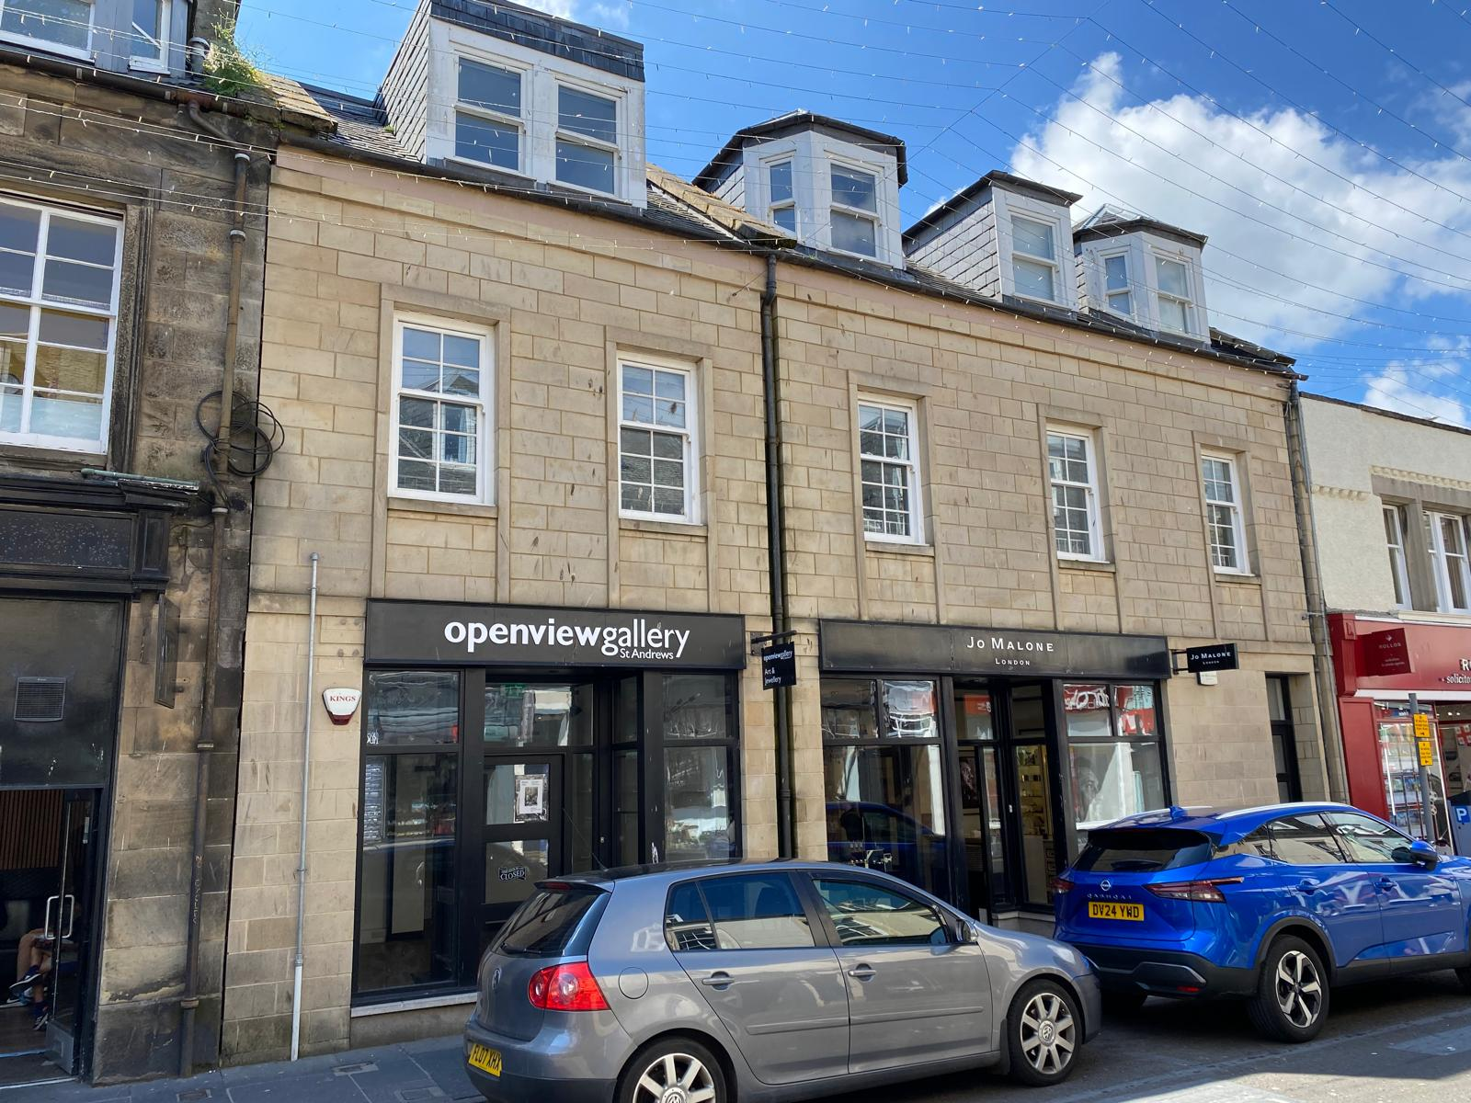
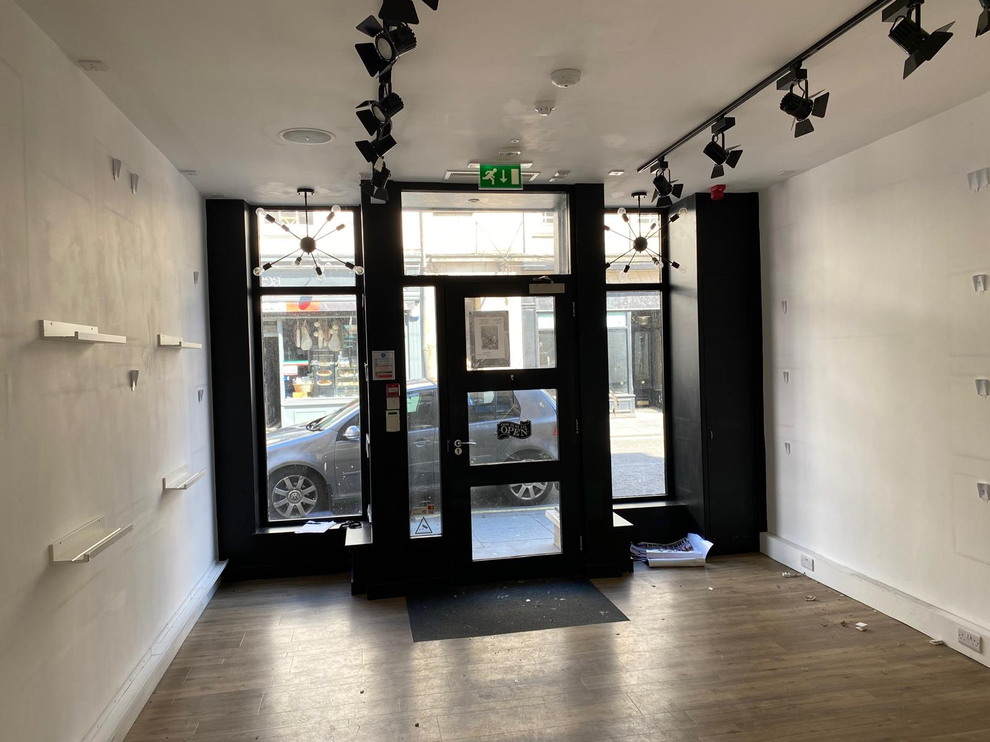
12 Bell Street, St Andrews, KY16 9ux
Location
The university town of St Andrews is situated on the north east coast of fife approximately 25 km (15 miles) south of Dundee, 56 km (35 miles) east of Perth and circa 80 km (50 miles) north east of Edinburgh.
The town has a resident population of some 25,000 persons which is boosted by an influx of approximately 8,000 students during term time.
Additionally, St Andrews is known throughout the world as the home of golf and is an important historic town which ensures a healthy flow of tourists all year long.
The property is prominently located on Bell Street approximately mid way between its junctions with Market Street and South Street in a good class retail location.
DESCRIPTION
During 2014 the property was developed and a new 2 storey and attic building was constructed, comprising 2 ground floor retail units and 3 residential flats.
The property was built around a steel frame with brick and block walls, partly rendered and with natural stone facing to the front elevation. The roof is pitched and laid in slate.
The property is accessed via traditional pedestrian door to the front elevation with typical window display frontage.
Internally the property is well presented with plastered walls and ceiling, solid concrete floor.
ACCOMMODATION | m² | ft²
Ground Floor
Sales Area, Rear Store & W.C. | 28.67 | 309
TOTAL | 28.67 | 309
RATEABLE VALUE
£16,600
epc
Available upon request
terms
Our client is inviting rental offers in the region of £25,000 per annum for a negotiable period of time.

Slide 3
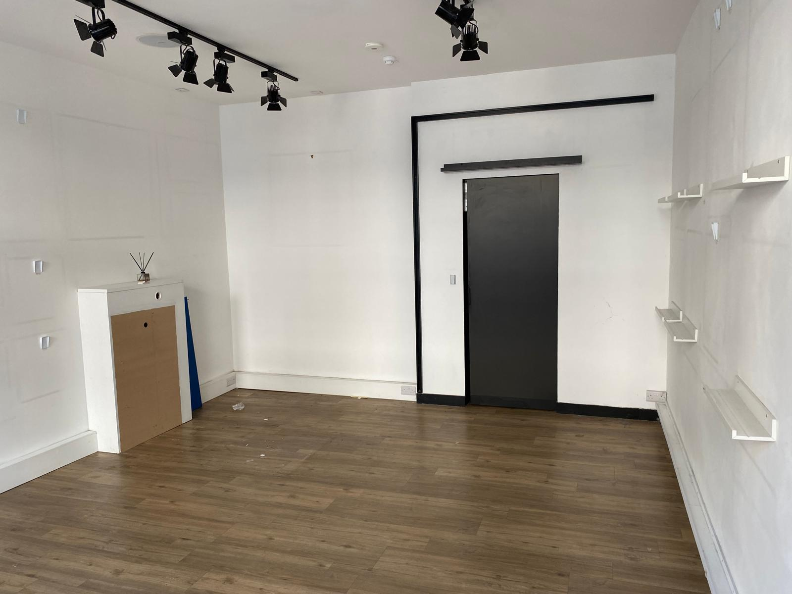
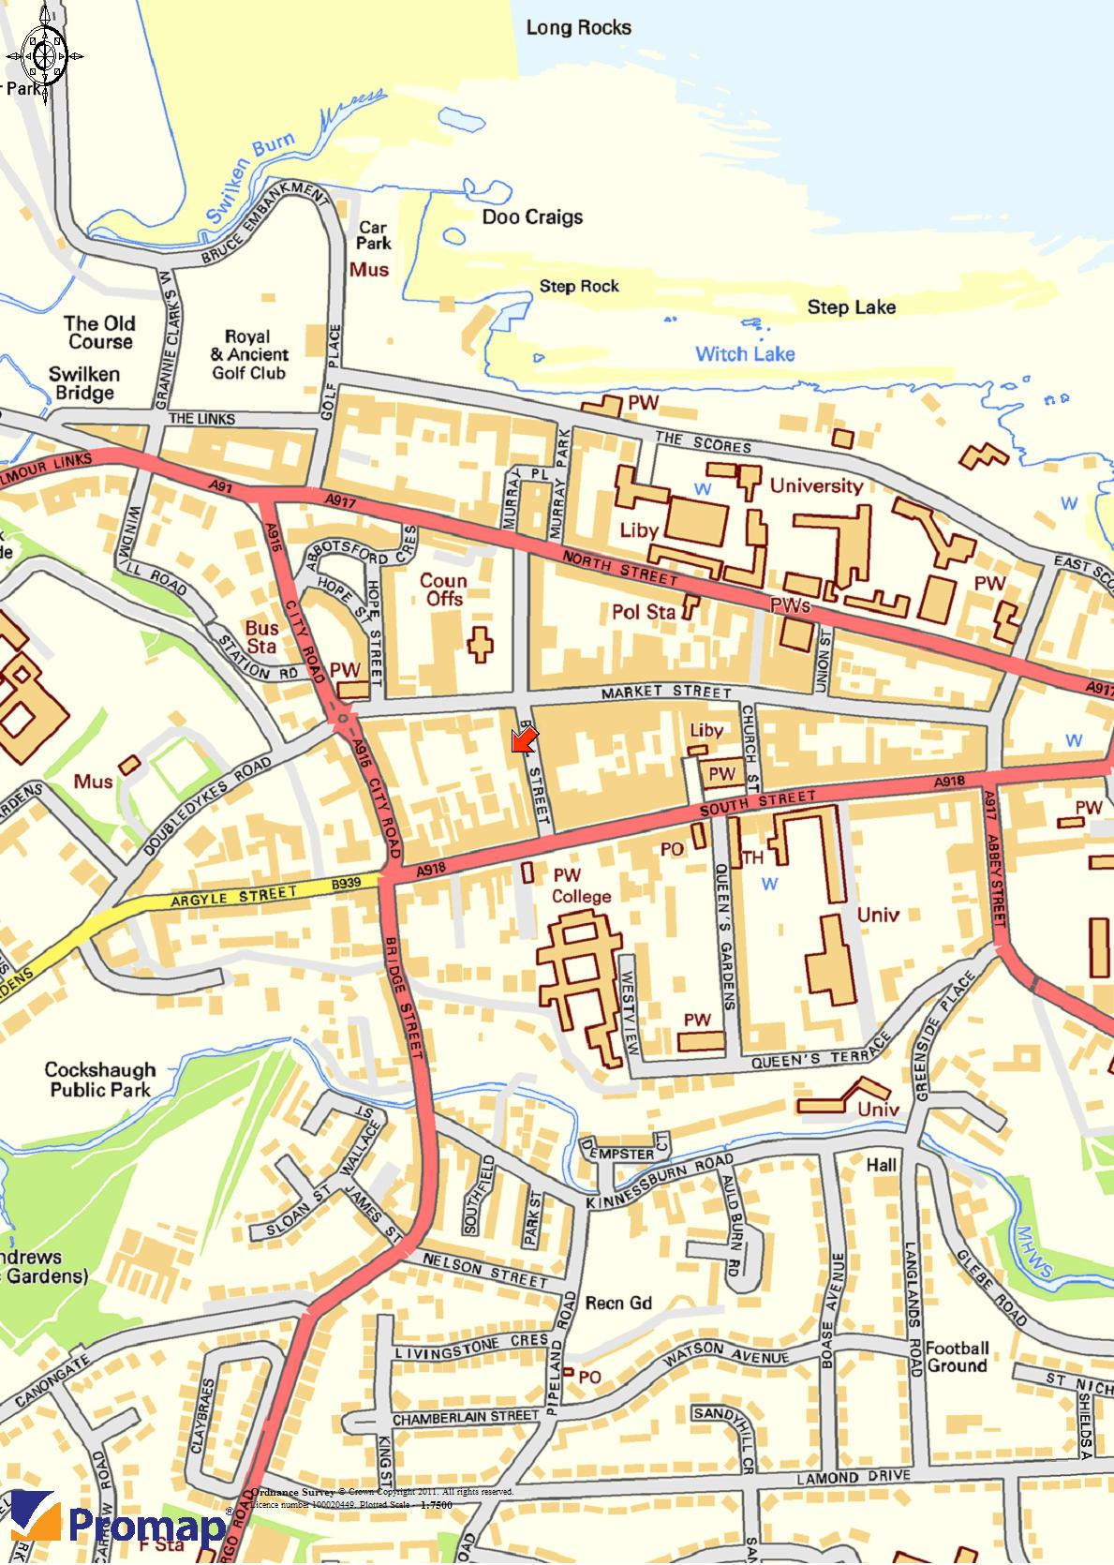
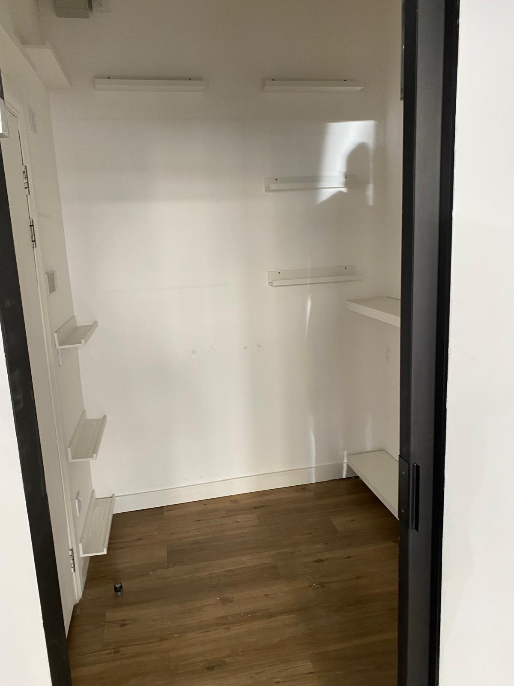
12 Bell Street, St Andrews, KY16 9ux
VAT
Prices are quoted exclusive of VAT.
LEGAL COST
Each party will bear their own legal costs in connection with this transaction.
MONEY LAUNDERING
The money laundering, terrorist financing and transfer of funds (information on the payer) regulations 2017 came into force on the 26th June 2017. This now requires us to conduct due diligence not only on our client but also and any purchasers or occupiers. Once an offer has been accepted, the prospective purchaser(s)/occupier(s) will need to provide, as a minimum, proof of identity and residence and proof of funds for the purchase, before the transaction can proceed.
Further information and viewing
Further information and viewing arrangements are available by contacting the Agents.
13 Albert Square, Dundee, DD1 1XA – 01382 878005
Jonathan Reid - j.reid@shepherd.co.uk 01382 878005 www.shepherd.co.uk
Chris Paterson – cp@bap.co.uk 0131 228 4466 www.bap.co.uk
Publication: JUNE 2024

